Slide 1

Introduction to R – Pt.1
Data exploration

Slide 2


What is R?
R is a computer programming language
It is a way of communicating with a computer
R was developed for and by statisticians, therefore very good for visualizing + analysing data
I would like to plot a bar graph from my incidence data
Je voudrais tracer un diagramme à bandes de mes données incidence
Notes:
We just need to figure out how to translate what we want to do into the R language, you can translate it to French, or even other programming languages like python.
They all generally do the same thing, just have different syntax so it communicates with the computer differently

Slide 3
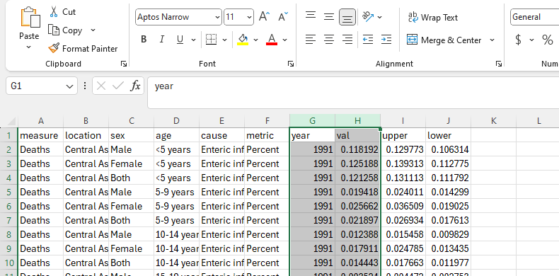

The old ways…
Excel is software we can use to store and explore .csv and .xlsx files
Ultimately these files are rows and columns of text/numeric data
Functions can be used to summarize data e.g get the mean value of a column, but this requires lots of clicking!
What if you have 20,000+ rows of data for each gene, for 1000+ people, that’s a lot to load and analyse!
R helps us automate the analysis, instead of clicking over our data, we can type a line of code to select the data for us
Notes:
Also makes it reproducible, new data set, just load it up and run your script and you can get the exact same analysis/graphs as your first data set, very hand if you’re repeating experiments or getting updated clinical trial data

Slide 4

What makes up R
Objects – things you create, e.g data frames, lists, plots
Functions e.g plotting graphs, joining tables, sorting data
Operators – includes symbols we use to assign objects <- or =
and mathematical functions e.g / * + -
Scripts – where we write and save our code to run the analysis
I would like to plot a bar graph from my incidence data and save it as a new graph
new_graph <- ggplot(data = incidence_data aes (x=year, y=cases) + geom_bar()
Notes:
Go into more detail later how to assign these things in R?
Onjects saved in the internal memory (not yet saved to disk/new files)
Everyone writes code differently as you can see you need to know what to save your object as at the start of the code. I normally write and test out my code and then go back to save it

Slide 5
What makes up R
Packages – contain groups of functions which can help manipulate, analyse, visualize data
The package authors made functions which wrap around lots of code so you don’t have to think about it!
Installed from CRAN or Bioconductor
Contain documentation and help
library(ggplot2)
new_graph <- ggplot(data = incidence_data, aes (x=year, y=cases) + geom_bar()
Notes:
Packages – made for specific tasks,

Slide 6
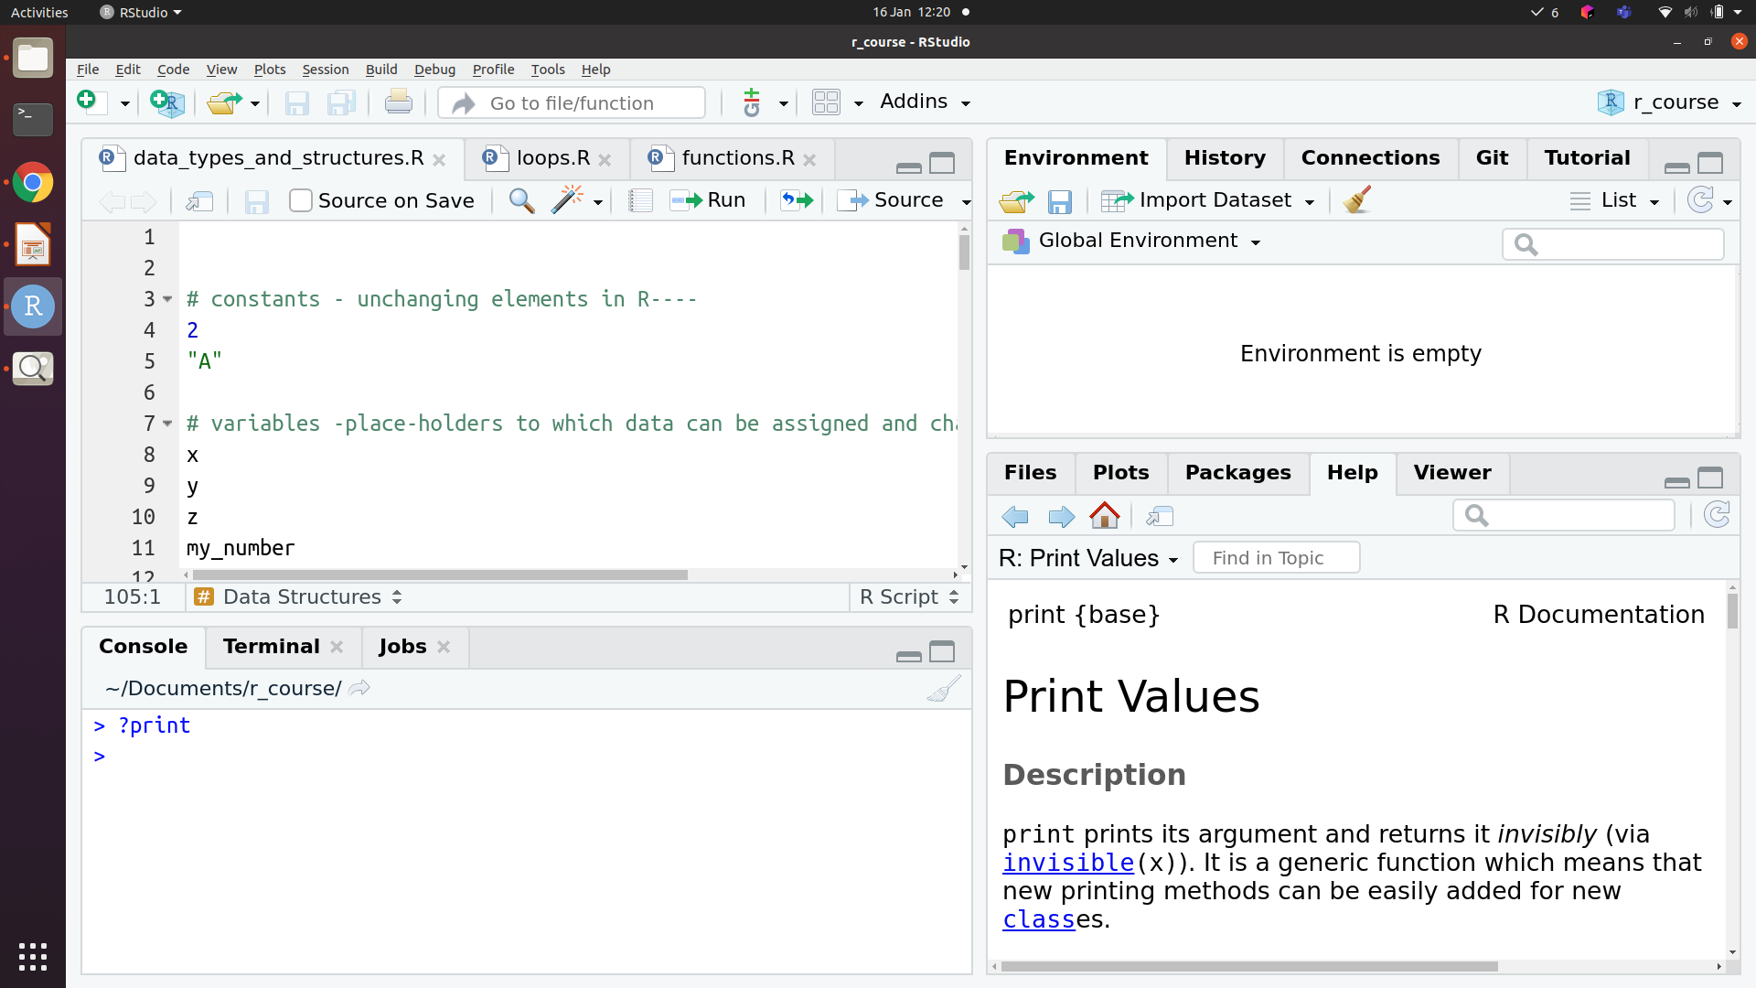
R Studio
RStudio software provides a GUI that lets us visually explore data in R
Write our code: script
Run our code: console
Save objects: environment
View file directories, plots and package help
Your R (Rstudio) environment
Script
Environment
Files/ Help / Plots
Console
Notes:
Rstudio is software with a GUI that lets us visually explore data in R (like excel)
Save objects to internal environment ()
When in R to r in the script ctrl + Enter or cmd Enter Mac to run line of code
In console you can run things directly by pressing enter

Slide 7
Objects in R
Data.frame
Data organised into rows and columns; elements of each column are of the same type, but different columns can be of different types. Tibble is a 'neater' style of data frame
1
2
3
4
1
2
3
Matrix
All elements are of the same type, data organised in rows and columns (normally all numeric data)
1
2
3
4
1
2
3
Atomic vector
All elements are of the same type. Different vector types e.g character numeric, logical (categorical data)
1
2
3
4
1
2
3
4
1
2
3
4
“a”
“a”
“c”
“f”
1
2
1
4
T
F
T
T
Notes:
R is an object-based programming language, because everything we do in R will revolve around manipulating and creating objects with our functions, and these objects can be reaccessed and manipulated over and over again
Data are assigned to objects in R e.g data frames or vectors
Each object has a class e.g charcter vector, numeric vector, data.frame, list
Can covert data classes using as.factor() or as.numeric() functions
Check class using class(object)
It’s important to understand the type of data you’re working with in R as this will often be necessary to streamline downstream processes such as manipulating or plotting your data, for example we need a time point saved as a factor (pre – post) but it often initially reads it as a character
Factors and dates aren't basic data types, under the hood they are integers but R translates it into a class that we can maniputlate

Slide 8
Objects in R: List
List
Elements can be different types, elements can also be other data structures
1
2
3
4
1
2
3
1
2
3
4
1
2
3
4
1
1
2
3
4
1
list
T
F
T
T
“a”
“a”
“c”
“f”
2
2
3
3
Notes:
Can also be multiple of same elements, e.g lots of data frames

Slide 9
Object Classes
All the objects stored in R have a class which tells R how to handle the object
Data.frame
Tibble
Matrix
List
Character
Numeric
Integer (Whole numbers)
Logical
Factor (categorical data)
1
2
3
4
1
1
2
3
4
1
2
3
4
1
2
3
4
2
“a”
“a”
“c”
“f”
1
2
1
4
T
F
T
T
3
Notes:
Class as the type of object or data we are working with

Slide 10


Let’s Explore

Slide 11
Subset objects (base R)
[ ] – To get a subset of elements
[[ ]] – To get a specific element from a list (or a column of a data.frame)
$ - To subset a specific column in a data frame
Notes:
Generally a bit quicker when you know the index column names

Slide 12
Explore in R

Slide 13
Dplyr package
Uses different syntax to base R, works on tidy data
Contains functions to help us subset, filter, join data frames
Instead of data$column or data[,4], we could write: select(data, column)
Also contains the pipe operator %>% , passes objects to the function
data %>% select(column) %>% filter() %>%
Notes:
Helpful when doing lots of operations, more like human language

Slide 14
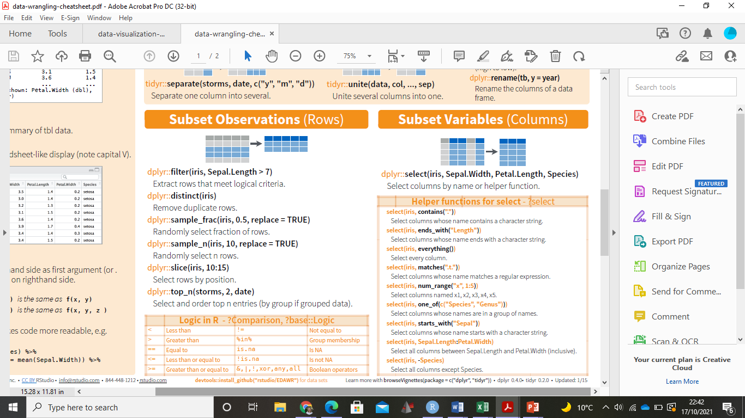
Subset using dplyr package: %>%
Iris is a data frame containing observations about different types of flowers
Notes:
Logical conditions

Slide 15
Filter – Logical conditions
Notes:
example

Slide 16
Explore in R

Slide 17
Extra slides
You write R code (e.g., x <- 1 + 1)
This is a human-readable instruction.
The R interpreter reads your code
R is an interpreted language, meaning each line is translated and executed immediately by the R engine (written mostly in C).
The interpreter parses and evaluates the code using a C-based backend.
R sends system-level instructions
When you run something like read.csv(), R calls underlying C functions or system calls to ask the operating system for help (like accessing the file system).
The operating system (Windows, macOS, Linux) interacts with:
Memory (RAM) to store variables and objects
CPU to do calculations (math, logic, loops)
Storage to read/write files
Other hardware (like graphics for plotting, network for downloading)

Slide 18
Math operations
Add, subtract, divide, multiply
+ - / *
Modulo (remainder of division)
%%
Exponent
^
Rounding
round(), floor(), ceiling()
Top tip: as you would with excel, remember brackets when writing equations (BODMAS)
Notes:
Like in Excel you can perform calculations, the difference being instead of appending them we save them as a data frame

